Slide 1
ESRI Geodatabases
Ming-Chun Lee

Slide 2
Terminology
dataset = data set = data layer = layer = theme = feature class (vector data model)
All mean “a piece” of geospatial data
Feature dataset however means a collection of feature classes in a ESRI geodatabase
data model → either Vector or Raster

Slide 3
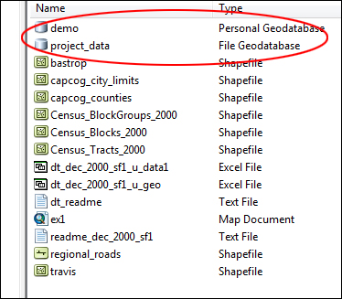
Geodatabase
A geodatabase is a collection of data sets and acts as a container for data
You can store shapefiles, areial photos, spreadsheets, and many other types of files
Geodatabases store both geospatial and attribute data in the same structure

Slide 4
Advantages
All files relating to a project can be stored into the geodatabase file, making it easier to organize and transfer data if necessary.
Both the geographic files and the tabular data can reside within a single geodatabase.
You can enforce extents, storage types, projections, topology rules, connectivity rules, network-specific rules, and so on.

Slide 5
ESRI Geodatabases
File Geodatabase
Introduced in 9.2, the File Geodatabase is the latest, greatest file-based format from ESRI
Personal Geodatabase
Introduced in 8.x
Based on Microsoft Access/Jet Engine
ArcSDE
Software (now part of ArcGIS core) that allows RDBMSs to act as GIS data stores.

Slide 6
File Geodatabase
Latest format
Best modern format for large datasets
Very efficient use of storage space
What you should be using for significant work
Stores data on disk in several files within a directory named geodatabase.gdb

Slide 7
Personal Geodatabase
Based on Microsoft Access, easier for Access users to work with the data within the tables outside the ArcGIS environment
Great for bringing outside data into ArcGIS
Limited to 2GB
Becomes slow as amount of data increases
Stores data in one file called geodatabase.mdb

Slide 8
ArcSDE/Enterprise database
Most likely stored on an entirely different machine from the one you’re running ArcGIS on
Concurrent users (multi-user and replication)
Managed (hopefully) by a DB administrator

Slide 9
When to use geodatabase
Not really needed, If only use a few shapefiles for a project
Recommended for projects that require a significant amount of data, in particular, data in many different formats (data models)

Slide 10
Working with Geodatabases
Geodatabases support additional functionality, such as topologies, raster catalogs, network datasets, terrain datasets, address locators, and so on.
This additional functionality is implemented through Feature Dataset

Slide 11
Feature Dataset
A “folder” within the GDB, it preserves projection and extent information for data within the folder (“feature classes”)

Slide 12
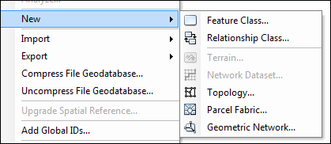
Additional Functionality
In your Feature Dataset, right click and see what pops up under New >
Topology
Geometric Network
Network Dataset
Etc…

Slide 13
Geodatabase as a container
Each of these special functionalities uses the GDB to store data specific to its framework
Topology stores associated attribute tables, rules, and error information
Network stores network edge attributes, turn tables, and driving/routing directions

